Slide 1
TEAM!!! 😃 😄 😁 😆 😅 😂 🤣 🥲 ☺️
James You

Slide 2
Learning Outcomes
What is a good team
How to become a good team
What roles to play in your team
Good things to do in a team 😉
Notes:
Explain the backend code here

Slide 3
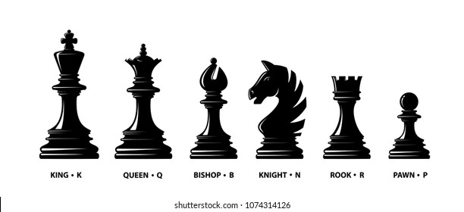
What is a Team
Chess

Slide 4
How to form a good team (individually)
Know who you are
Know what you are good at
Know what you are not good at

Slide 5
How to form a good team (as a team)
Open up the communication
Resolve conflicts
Commitment

Slide 6
Let’s do some role playing
Discuss within your team
Around 5 minutes per person to talk:
What role you played in the past
What role you would like to play in this team
James will pop in and say hi!

Slide 7
Any findings?
Shout out your thoughts, no one? I will shout out your name 😈
Surely you know who you are and what you want to be in a team

Slide 8
Become better
Communication, communication, communication
Keep exploring
What role you would like to play in this team

